Slide 1


Collin County Judge and Mayors Meeting: Fire Districts
January 30, 2025

Slide 2
Overview
Welcome and Introductions
Collin County Fire Districts
Fire Service Revenue Sources
Emergency Services District
Next Steps & Decision Points
Q&A

Slide 3
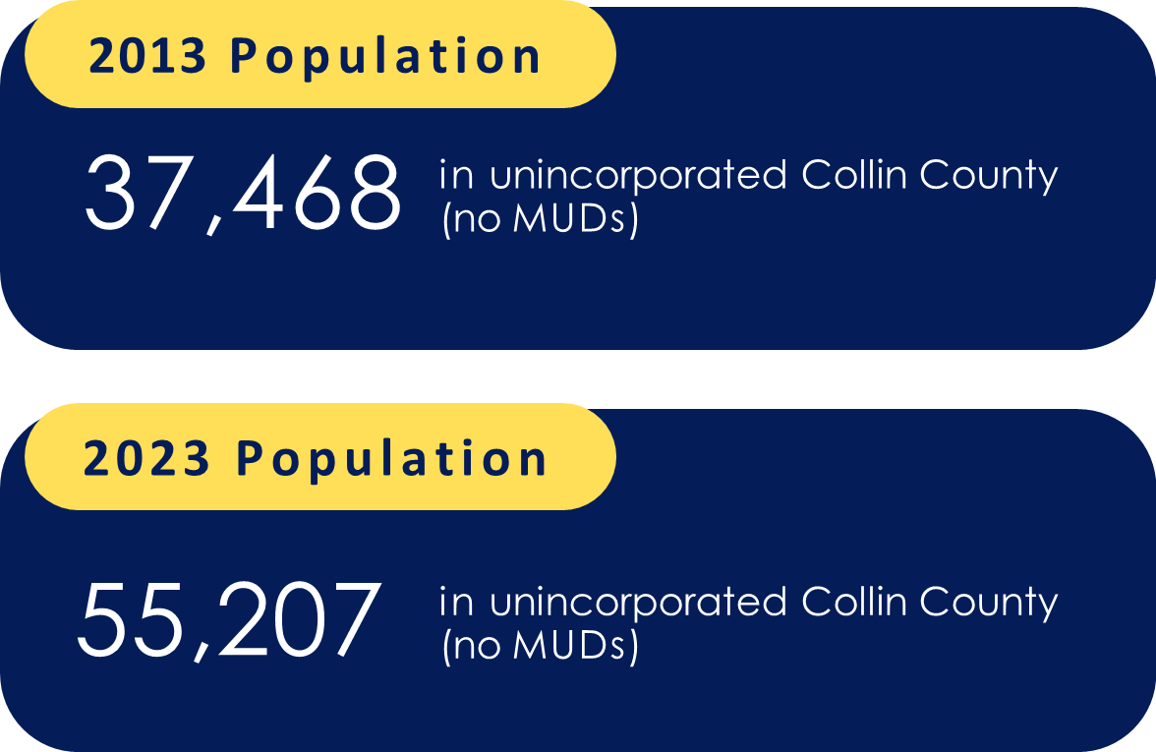
Collin County
Population InformationServices Agreements
Cities included in the Petition
Allen
Anna
Blue Ridge
Celina
Fairview
Farmersville
Fate
Frisco
Garland
Hebron
Josephine
Lavon
Lowry Crossing
Lucas
McKinney
Melissa
Murphy
Nevada
New Hope
Parker
Plano
Princeton
Prosper
Royse City
St. Paul
Trenton
Van Alstyne
Weston
Wylie

Slide 4

Emergency Services District
~350 ESDs in Texas
Commissioners Court appoints Commission members (5 total) to staggered two-year terms
ESD Board of Commissioners adopts the tax rate and sets the budget annually after the Commissioners Court sets the initial rate
$0.10 constitutional cap on tax rate
3.5% voter-approval rate

Slide 5
Emergency Services District
TY 24 - ESD Property Tax Levy
 |  | 2024 Taxable Value | $0.05 Rate | $0.025 Rate
Collin Co MUDs | $ | 6,544,367,805 | $ 3,272,184 | $ 1,636,092
Unincorporated (No ETJ/MUDs) | $ | 3,347,983,283 | $ 1,673,992 | $ 836,996
City Extraterritorial Jurisdictions (ETJ) | $ | 13,314,082,127 | $ 6,657,041 | $ 3,328,521
 | $ | 23,206,433,215 | $ 11,603,217 | $ 5,801,608
Above demonstrates the range of possible ESD levy. If all cities allow their ETJ to be included in the ESD boundaries and MUDs are part of the ESD, there is $23.2 billion in taxable value. If all cities do not allow their ETJs to be included in the ESD boundaries, the lowest taxable value is
$3.3 billion.
Additionally, ESD voters can approve up to a two (2) cent sales tax in the unincorporated area.

Slide 6
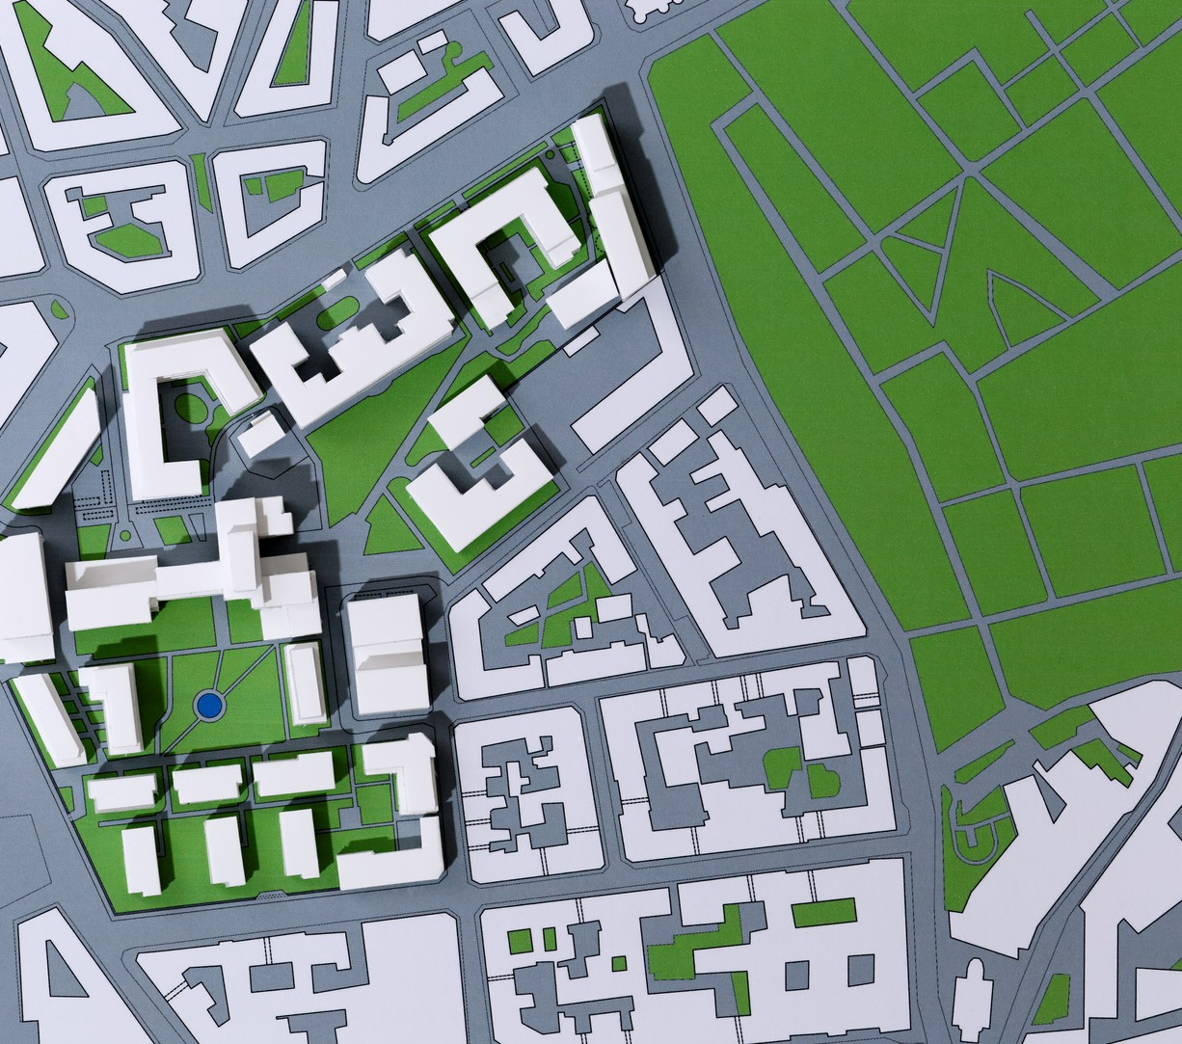
Emergency Services District
Texas Constitution, Article 3, Section 48-e
Health and Safety Code Chapter 775 Petition with metes and bounds description of the district signed by 100 eligible residents
Commissioners Court receives and calls the election
Cities have 60 days to determine if ETJ is included in the ESD
Existing MUDs, if included in the petition, can be part of the ESD

Slide 8
Gap Year
ESD Election – November 4, 2025
Fire District Gap Year – October 1, 2025 – Sept. 30, 2026
ESD Budget Effective – October 1, 2026
Tax Collection – January 31, 2027

Slide 9
Next Steps
Petition Process
Municipal Consent of ETJ
Election Process
  Public Hearing
Decision Points
ETJ Consent
Gap Year Participation

Slide 10
Questions?

